Slide 1
Site Selection for Services
Chapter 16

Slide 2
Type of Service
Quasi-Manufacturing
  Goal - minimize logistics cost of a network
  Examples - warehouses, call centers
Delivered
  Goal - covering a geographic area
  Examples -
    Public Sector - fire protection, emergency medicine
    Private Sector - food delivery, saturation strategy
Chapter 16 – Site Selection
Successful Service Operations Management, 2006, Thomson

Slide 3
Type of Service
Demand Sensitive
  Goal - attract customers through location
  Examples - banks, restaurants
Academic Challenge:
  Turn “gut feel” into science
Chapter 16 – Site Selection
Successful Service Operations Management, 2006, Thomson

Slide 4
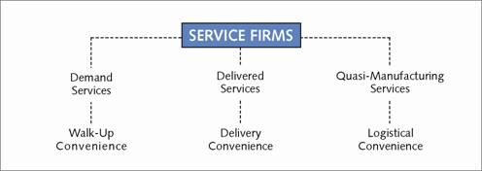
Types of Service Firms and the
Main Goal of Facility Location
Chapter 16 – Site Selection
Successful Service Operations Management, 2006, Thomson

Slide 5
Demand Sensitive Service Facility Location
Use location to generate demand
Managerial Challenge: Forecasting demand for specific locations
General Marketing/Operations Strategies
Site Specific Considerations
Chapter 16 – Site Selection
Successful Service Operations Management, 2006, Thomson

Slide 6
Demand Sensitive Services
Solution Techniques:
  Informal judgment
  Factor Rating
  Regression
Case:
  La Quinta Hotels - Regression based site selection
Chapter 16 – Site Selection
Successful Service Operations Management, 2006, Thomson

Slide 7
Characteristics of a Good Location
Proximity to target market
  Residences, hospitals, schools, offices, airports, military bases
Proximity to destination points
  Malls tourist attractions, anchor stores
Ease of access
Proximity to competition
Proximity to other units of the same type
Problem: accurate identification and trade-offs
Chapter 16 – Site Selection
Successful Service Operations Management, 2006, Thomson

Slide 8
Demand Sensitive Service Facility Location
Factor Rating example
Item Range
Income of neighborhood 0-40
Proximity to shopping centers 0-25
Accessibility 0-15
Visibility 0-10
Traffic 0-10
OR…
Chapter 16 – Site Selection
Successful Service Operations Management, 2006, Thomson

Slide 9
Demand Sensitive Service Facility Location
Factor Rating example
Item Scale Multiplier
Income of neighborhood 0-10 .40
Proximity to shopping centers 0-10 .25
Accessibility 0-10 .15
Visibility 0-10 .10
Traffic 0-10 .10
Chapter 16 – Site Selection
Successful Service Operations Management, 2006, Thomson

Slide 10
Demand Sensitive Service
Facility Location
Factor Rating Example
 | Springfield | Tyson's Corner | Gaithersburg | Alexandria
Income | 4 | 8 | 10 | 6
Shopping | 2 | 7 | 10 | 4
Access | 1 | 9 | 8 | 4
Visibility | 6 | 9 | 7 | 6
Traffic | 3 | 8 | 8 | 5
Springfield | 3.15
Tyson's Corner | 8.00
Gaithersburg | 9.20
Alexandria | 5.10
Score
Chapter 16 – Site Selection
Successful Service Operations Management, 2006, Thomson

Slide 11
Demand Sensitive Service
Facility Location
Regression Based - find variable weightings from previous locations
La Quinta Case
  Develop regression model for prior hotels
  Apply model results to a new site
Chapter 16 – Site Selection
Successful Service Operations Management, 2006, Thomson

Slide 12
Regression Review
Variable selection - Theory First
Data types
  Ratio
  Ordinal
  Categorical
Transforming variables
Outliers
Relevance of seemingly irrelevant variables
Chapter 16 – Site Selection
Successful Service Operations Management, 2006, Thomson

Slide 13
Data Types
Ratio
  Ratios are meaningful: 6 apples are twice as good as 3 apples
Ordinal
  Implies better or worse, but ratios are not meaningful: private=1, corporal=2, ... general=15
Categorical
  Coded categories, 2 is not better than 1. 1 if red, 2 if blue, 3 if green
Chapter 16 – Site Selection
Successful Service Operations Management, 2006, Thomson

Slide 14
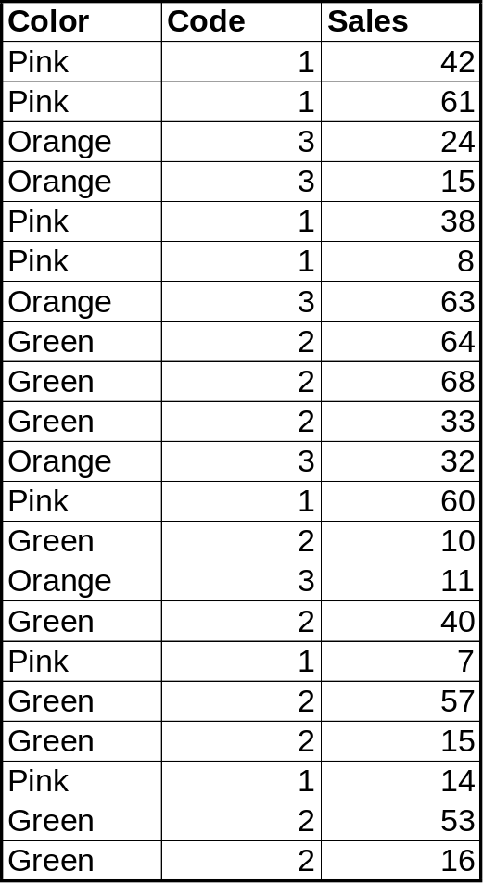
Regression with Categorical Data
Chapter 16 – Site Selection
Successful Service Operations Management, 2006, Thomson

Slide 15
Exploratory Data Analysis
Finding relationships
  Mean/variance
  Scatter plots
  Correlation matrix (regular and transformed variables)
Outliers
Chapter 16 – Site Selection
Successful Service Operations Management, 2006, Thomson

Slide 16
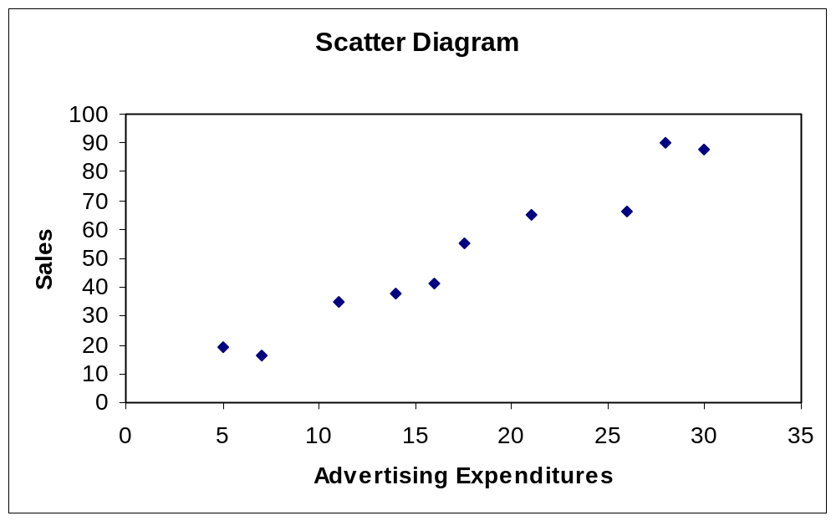
Scatter Diagram
Chapter 16 – Site Selection
Successful Service Operations Management, 2006, Thomson

Slide 17
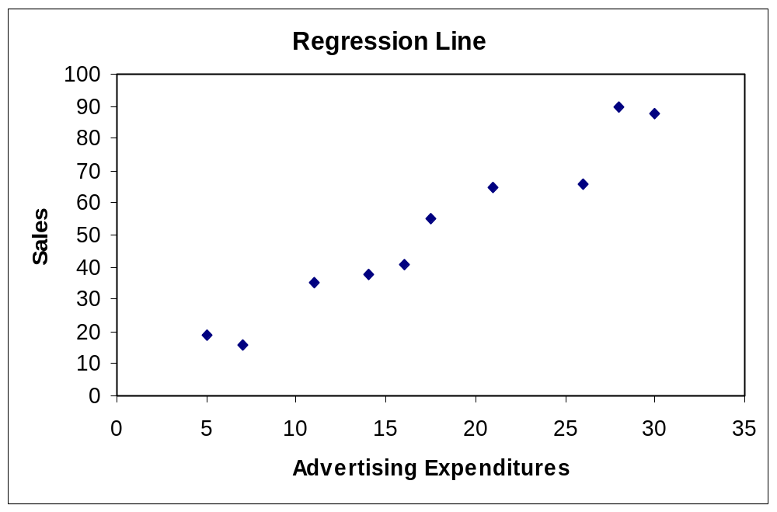
Regression Line
Chapter 16 – Site Selection
Successful Service Operations Management, 2006, Thomson

Slide 18
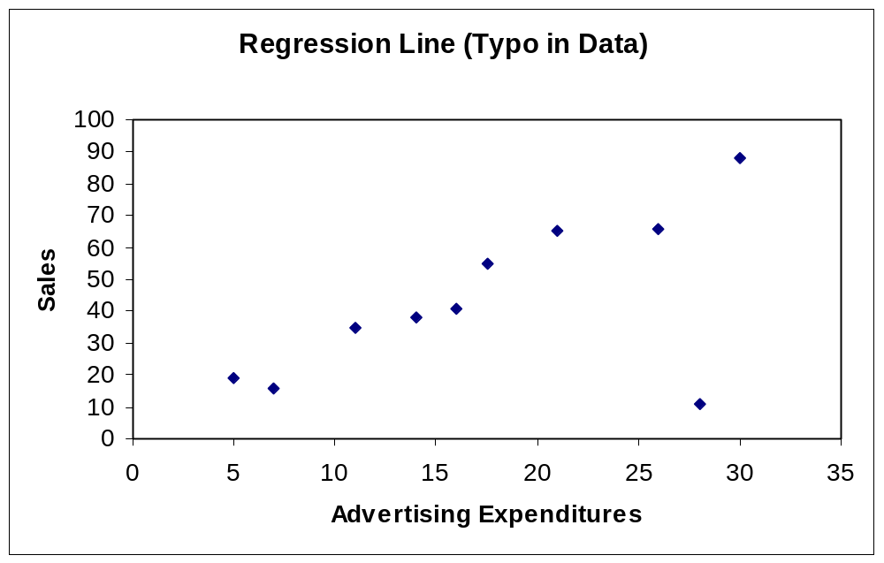
Regression Line w/ Typo (outlier)
Chapter 16 – Site Selection
Successful Service Operations Management, 2006, Thomson

Slide 19
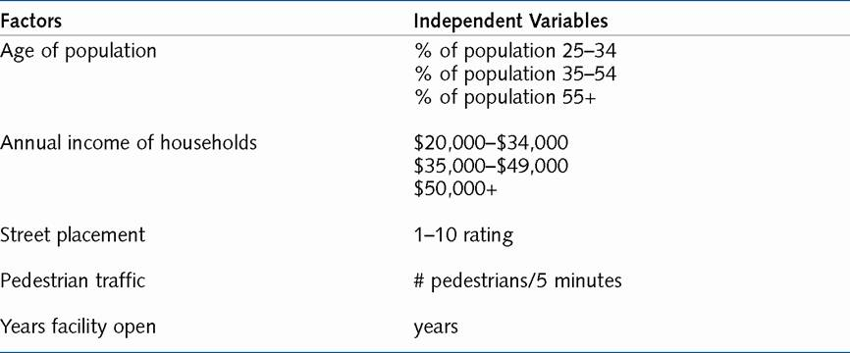
First American Bank Site Selection Independent Variables
Chapter 16 – Site Selection
Successful Service Operations Management, 2006, Thomson

Slide 20
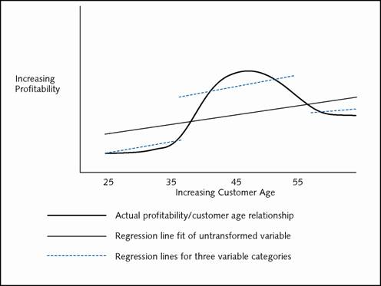
Transforming Variables: Hypothetical Relationship of Profitability and Customer Age
Chapter 16 – Site Selection
Successful Service Operations Management, 2006, Thomson

Slide 21
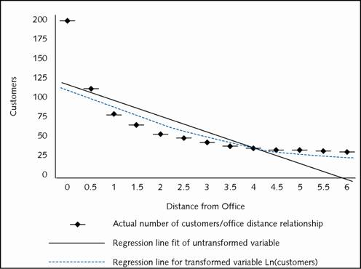
Transforming Variables: Customer Patronage of a Restaurant and Distance from the Workplace
Chapter 16 – Site Selection
Successful Service Operations Management, 2006, Thomson

Slide 22
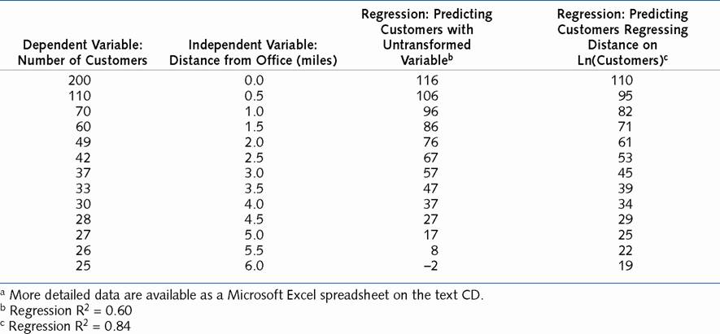
Transforming Variables in Restaurant Problemª
Chapter 16 – Site Selection
Successful Service Operations Management, 2006, Thomson

Slide 23
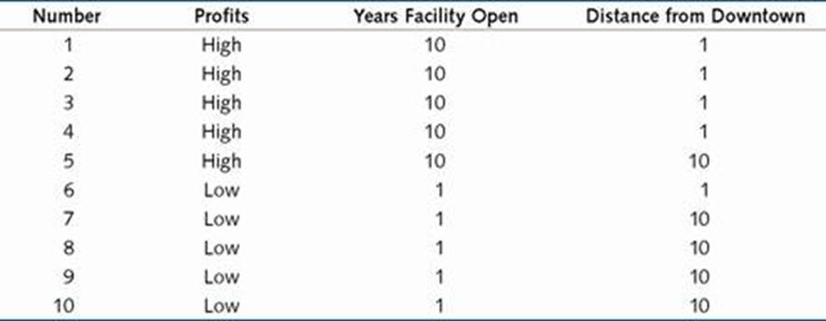
Hypothetical Relationship of
Facility Age and Profits
Chapter 16 – Site Selection
Successful Service Operations Management, 2006, Thomson

Slide 24
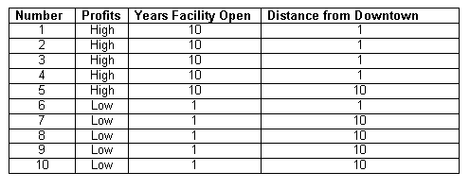
Necessary but Irrelevant Variables
Chapter 16 – Site Selection
Successful Service Operations Management, 2006, Thomson

Slide 25
Geographic Information Systems (GIS)
Purpose:
  Predict demand based on geographic databases
Other uses
  Sales territory partitioning
  Vehicle routing
  Politics
  Geography
  Biologists
  Environmentalists
Chapter 16 – Site Selection
Successful Service Operations Management, 2006, Thomson

Slide 26
Geographic Information Systems (GIS)
Size: $6Billion
Vendors: ESRI, Tactician, Intergraph, GDS, Strategic Mapping, Mapinfo
Users (ESRI): Ace Hardware, Anheuser Busch, Arby’s, AT&T, Avis, Banc One, BellSouth, Blockbuster, Chemical Bank, Chevron, Coca-cola, Dayton-Hudson…
Chapter 16 – Site Selection
Successful Service Operations Management, 2006, Thomson

Slide 27
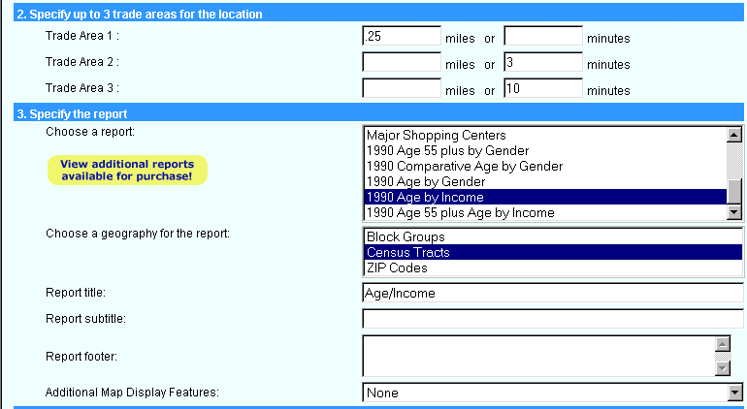
Tactition™ Report Choice
Chapter 16 – Site Selection
Successful Service Operations Management, 2006, Thomson

Slide 28
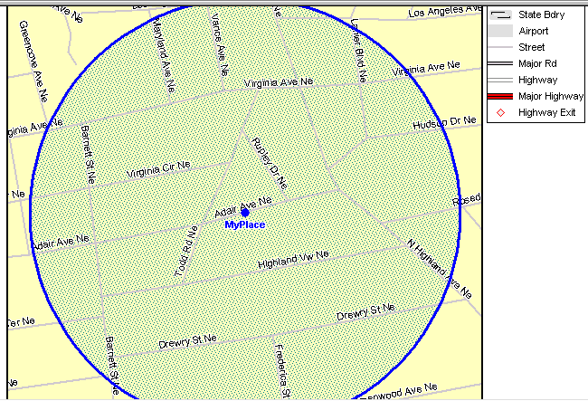
GIS Example:
Map of Area Within ¼ Mile
Chapter 16 – Site Selection
Successful Service Operations Management, 2006, Thomson

Slide 29
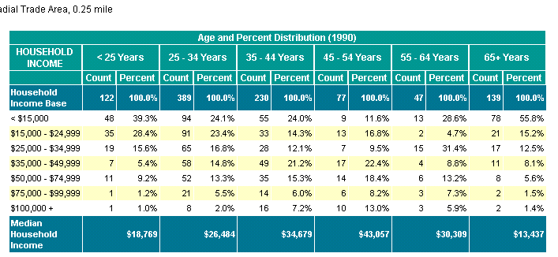
Demographic Information of Area Within ¼ Mile
Chapter 16 – Site Selection
Successful Service Operations Management, 2006, Thomson

Slide 30
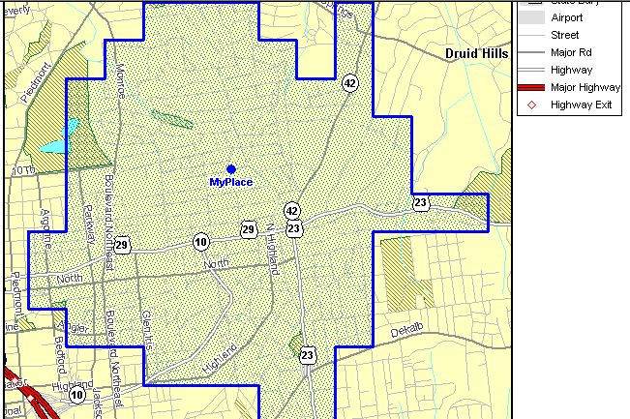
Map of Area within
Three Minute Drive
Chapter 16 – Site Selection
Successful Service Operations Management, 2006, Thomson

Slide 31
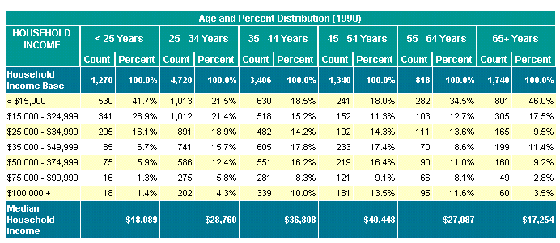
Demographic Information of Area Within Three Minute Drive
Chapter 16 – Site Selection
Successful Service Operations Management, 2006, Thomson

Slide 32
Delivered Services Facility Location
Criteria:
  Minimize costs of multiple sites that meet a service goal (e.g., everyone within a city boundary should be reached by ambulance within 15 minutes)
  OR, serve a maximum number of customers
"Set Covering" Problem
Managerial Decisions:
  How many facilities
  Location of facilities
Chapter 16 – Site Selection
Successful Service Operations Management, 2006, Thomson

Slide 33
Delivered Services Facility Location
Procedure:
  Establish service goal
  List potential sites or mathematically represent service area
  Determine demand from service area
  Determine relationship of sites to demand
    (yes or no decision, can site i meet demand at point j considering established service goal)
Chapter 16 – Site Selection
Successful Service Operations Management, 2006, Thomson

Slide 34
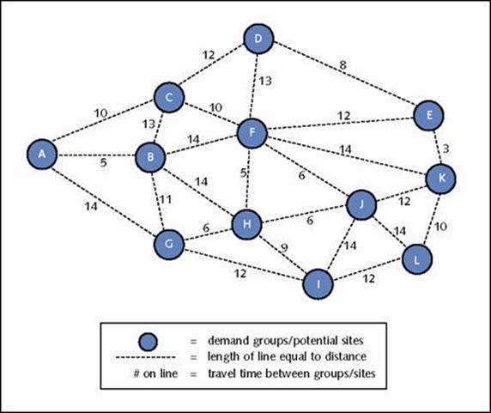
Figure 16.9: Example Problem for Delivered Services
Chapter 16 – Site Selection
Successful Service Operations Management, 2006, Thomson

Slide 35
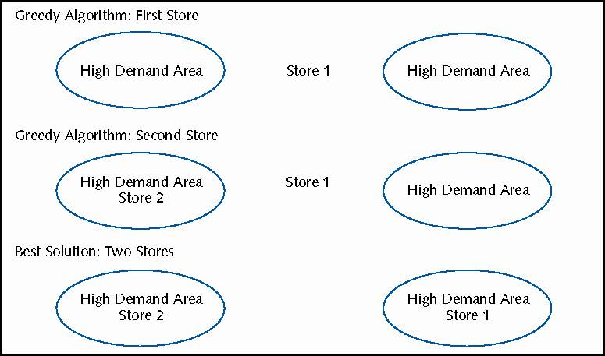
Delivered Services: Greedy Algorithm Versus Best Solution
Chapter 16 – Site Selection
Successful Service Operations Management, 2006, Thomson

Slide 36
Optimal Solution
(linear programming)
Minimize Loc1 + Loc2 + Loc3 +…
{minimize the number of locations}
subject to:
  Loc1 + Loc2 + Loc3 + Loc4 >=1 {Customer group 1 can only be served within the time frame by locations 1-4.}
  Loc1 + Loc2 + Loc3 >=1 {Customer group 2 can only be served by locations 1-3.}
  …
Chapter 16 – Site Selection
Successful Service Operations Management, 2006, Thomson

Slide 37
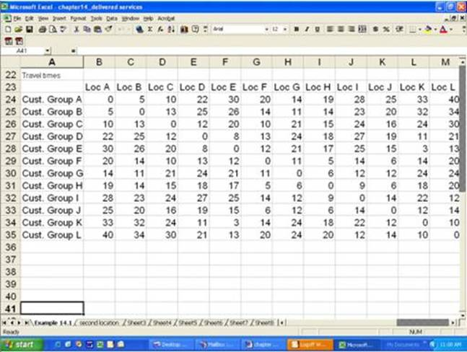
Travel Matrix for Figure 16.9
Chapter 16 – Site Selection
Successful Service Operations Management, 2006, Thomson

Slide 38
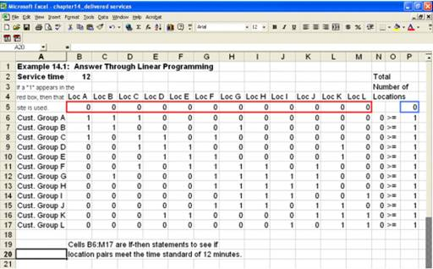
Mathematical Programming Formulation for Figure 16.9
Chapter 16 – Site Selection
Successful Service Operations Management, 2006, Thomson

Slide 39
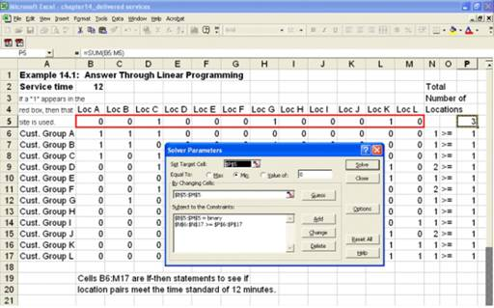
Mathematical Programming
Solution for Figure 16.9
Chapter 16 – Site Selection
Successful Service Operations Management, 2006, Thomson

Slide 40
Delivered Services - What Marketing Can Expect of Operations
Problems discussed:
  Covering area with a set of locations
    Ex.: Rural ambulance problem
  Need for a plan
    Ex.: Upscale service in Atlanta, locate in Buckhead or Preston Hollow?
Advanced Problems:
  Planning Backup
    primary service in 5 min., backup in 10
    Mobile Services - continuous dispatching
Chapter 16 – Site Selection
Successful Service Operations Management, 2006, Thomson

Slide 41
Quasi-Manufacturing Service Facility Location
Criteria: logistics cost minimization of multi-echelon system
Example: Stuff Products, Inc.
  Stuff Products has customers across the country and warehouses in New York, Chicago and Los Angeles. Below is a table of the costs of shipping a truck of Stuff from each warehouse to each demand point and the total demand at each point.
 | Philadelphia | Buffalo | Baltimore | Minneapolis | Cleveland | S.F.
New York | 50 | 70 | 70 | 200 | 150 | 500
Chicago | 200 | 200 | 250 | 100 | 50 | 300
L.A. | 350 | 350 | 350 | 300 | 300 | 100
Demand | 10 | 15 | 15 | 15 | 15 | 30
Chapter 16 – Site Selection
Successful Service Operations Management, 2006, Thomson

Slide 42
Quasi-Manufacturing Service
Facility Location
Formulate a linear program for Stuff Products, Inc. to determine the least cost solution to satisfy demand. Also, determine the best solution by hand (where “solution” means who should be served from which warehouse, not the total cost of the solution).
Chapter 16 – Site Selection
Successful Service Operations Management, 2006, Thomson

Slide 43
Quasi-Manufacturing Service Facility Location
Example: Stuff Products, Inc.: The Sequel
  Stuff Products has customers across the country and wants to know where to build warehouses. They have identified sites in New York, Chicago and Los Angeles. Each warehouse costs $X to maintain per year.
 | Phil | Buffalo | Baltimore | Minn | Cleve | S.F. | Capacity
New York | 50 | 70 | 70 | 200 | 150 | 500 | 50
Chicago | 200 | 200 | 250 | 100 | 50 | 300 | 50
L.A. | 350 | 350 | 350 | 300 | 300 | 100 | 50
Demand | 10 | 15 | 15 | 15 | 15 | 30
Chapter 16 – Site Selection
Successful Service Operations Management, 2006, Thomson

Slide 44
Quasi-Manufacturing Service Facility Location
Meta-problem of "Transportation" linear programming problem
Managerial Decisions:
  How many facilities
  Location of facilities
  Customer assignment to facilities
  Staffing/Capacity of each facility
  Location decisions reviewed frequently
Chapter 16 – Site Selection
Successful Service Operations Management, 2006, Thomson

Slide 45
Quasi-Manufacturing Service Facility Location
Commercial Software
  At least 16 vendors with prices from $5,000 - $80,000
  Solution Techniques
    Heuristics
    Deterministic simulation
    Mixed integer linear programming
  Limitations
    Models handle small list of potential sites
    No model provides optimal solutions
Chapter 16 – Site Selection
Successful Service Operations Management, 2006, Thomson

Slide 46
Quasi-Manufacturing Service Facility Location
Mixed Integer Linear Programming
  Some variables must be integers, others can be fractions
  Constants
    C - cost of serving demand point j with facility i
    K - cost of building/maintaining facility i
Chapter 16 – Site Selection
Successful Service Operations Management, 2006, Thomson

Slide 47
Quasi-Manufacturing Facility Location
Variables:
  X = how much from each facility i to each demand point j
  Y = 1 if build facility, 0 if not
Minimize Costs: ∑_{i} ∑_{j} C_{ij} X_{ij} + ∑K_{i}Y_{k}
  Subject to:
  ∑_{i} X_{ij} > Demand at point j
  ∑_{j} X_{ij} < Capacity at point i x Y_{j}
  Y_{j} Є {0,1}
Chapter 16 – Site Selection
Successful Service Operations Management, 2006, Thomson

Slide 48
Quasi-Manufacturing Facility Location
Example: AT&T 800 Service Location Decisions for Call Centers
  Criteria: minimization of telephone, labor, and real estate costs
  Old days: Omaha – the 800 capital of the world
  Today: Multiple sites, unusual telephone rate structures (e.g., site in Tennessee may not take calls from within Tennessee)
Chapter 16 – Site Selection
Successful Service Operations Management, 2006, Thomson

Slide 49
Quasi-Manufacturing Facility Location
Example: AT&T 800 Service
Model: Mixed integer linear program
Client Range
  46 clients in 1988 – retail catalogue, banking, consumer products, etc.
  1-20 sites
  Sites with 30-500 personnel
Chapter 16 – Site Selection
Successful Service Operations Management, 2006, Thomson

Slide 50
Chapter Summary
Factor rating, regression, and GIS offer tools to service firms to determine how to generate demand
Firms needing to cover a geographic area can use linear programming based tools
A variety of tools and software are available for quasi-manufacturing services including:
  Heuristics, deterministic simulation, and mixed integer/linear programming
Chapter 16 – Site Selection
Successful Service Operations Management, 2006, Thomson

